Slide 1
ITMD 525- DATA MINING
Final Presentation
By
Hemanth Inukonda Kamalakannan – A20369096
SreeKumar Selvam – A20372235
Srilekha Napa Ugandhar – A20370759

Slide 2

Predicting Twitter Sentiment Of The US Public Towards 2016 Presidential Election

Slide 3







Slide 4

Introduction
What is Sentimental Analysis?
A process of determining whether a piece of writing is Positive, Negative or Neutral.
What is Text mining?
A process of deriving high quality information from the text.

Slide 5
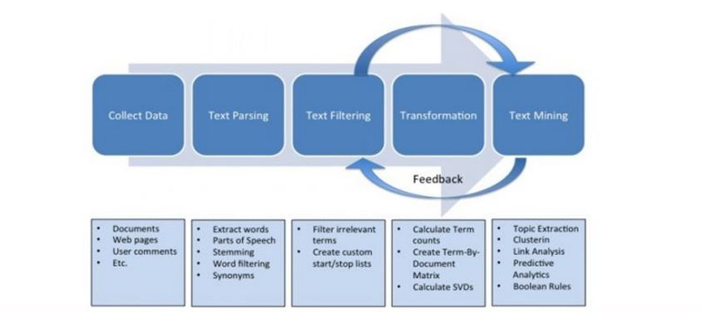
Text Mining Process

Slide 6
Implementation Steps
Collected tweets
Text Preprocessing
- Tokenization
- Pruning
- Filtering Tokens
- Text Transformation
Feature Selection
Labelling the Tweets
Finding public sentiments
Performing Classification algorithms

Slide 7

So how did we do?
Collecting Twitter data
Total number of Tweets -10000
Unique Tweets – 6000
Text Preprocessing
Removing
- @
- https,
- Stop word
- Punctuation
- Spaces.
- Special characters.

Slide 8
So how did we do?
Tokenization
Splitting the text in to sequence of tokens.
Pruning
Ignoring too frequent and too much infrequent words
Filtering Tokens:
Length based filtration schema was applied for reducing the generated token set.

Slide 9
So how did we do?
Text Transformation
-Stemming technique:
-Removal of prefixes and suffixes from words to reduce them to stems thus eliminating
tag of speech and other verbal or plural inflection.
-Increases the efficiency and effectiveness of text mining process.
Feature Selection:
-Based on TF-IDF ,describing how important a word is for a document.
- Bag of Words Model.

Slide 10
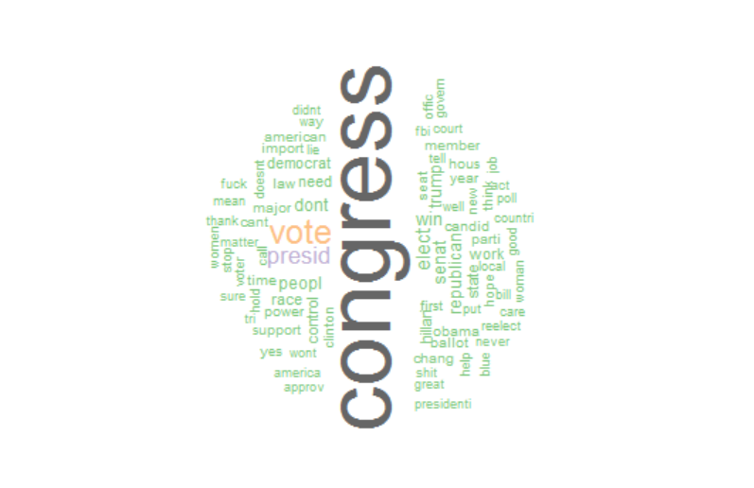
Word Cloud

Slide 11

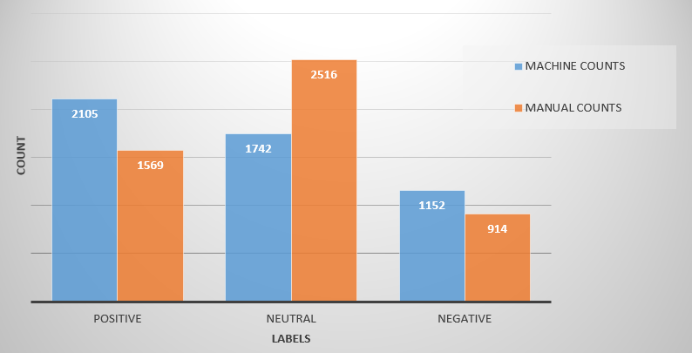
Methods to Label Sentences
Method 1-> Manual Counts
Method 2-> Machine Counts

Slide 12
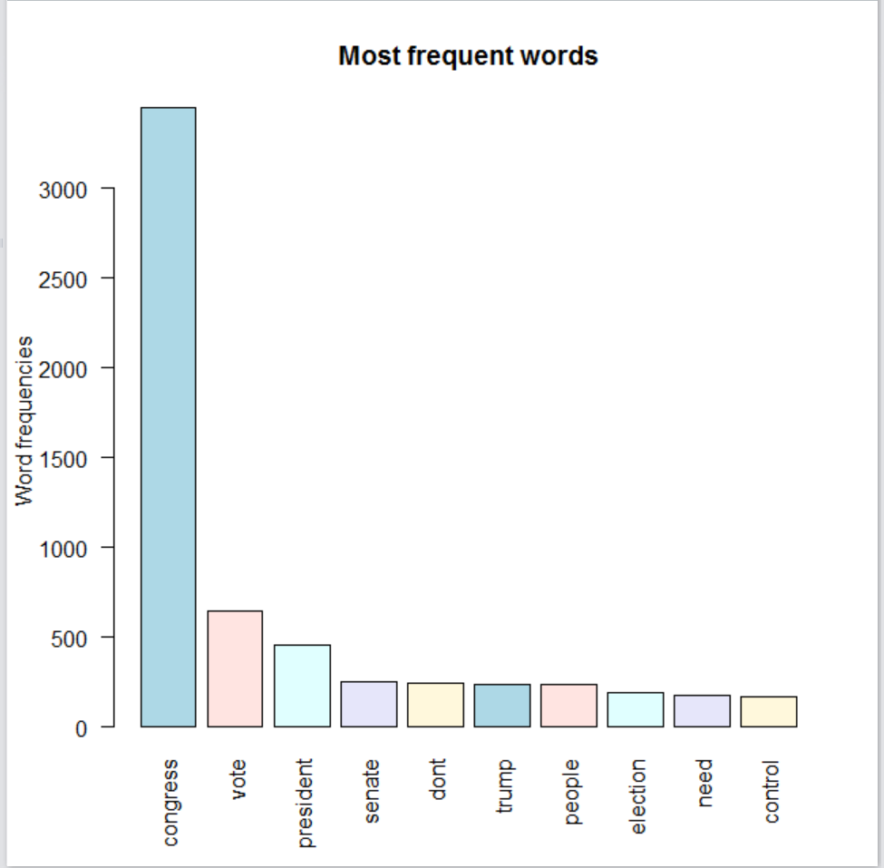
Frequency of words in Tweets

Slide 13
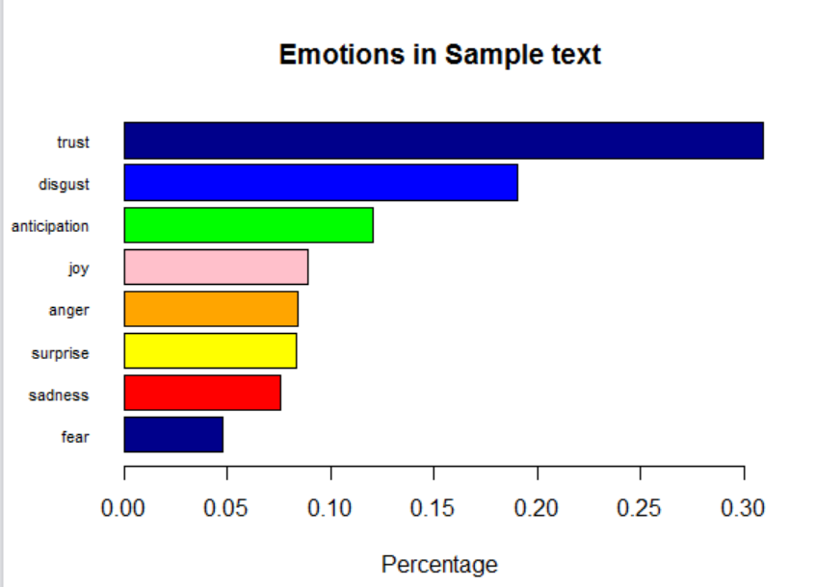
Public Emotions

Slide 14
KNN CLASSIFIER
The kNN classifier is based on the assumption that the classification of an instance is most similar to the classification of other instances that are nearby in the vector space.
Compared to other text categorization methods such as Bayesian classifier, kNN does not rely on prior probabilities, and it is computationally efficient.
The main computation is the sorting of training documents in order to find the k nearest neighbors for the test document.
The performance of this algorithm greatly depends on two factors, that is, a suitable similarity function and an appropriate value for the parameter k.

Slide 15

KNN CLASSIFIER
ACCURACY for N-fold Validation Method
Method 1: Method 2:

Slide 16
SUPPORT VECTOR MACHINE
The basic idea behind SVM classification is to find a maximum margin hyperplane that separates the document vector in one class from the other with maximum margin.
SVM use overfitting protection, which does not necessarily depend on the number of features, they have the potential to handle these large feature spaces.
SVM are well suited for problems with dense concepts and sparse instances

Slide 17
SUPPORT VECTOR MACHINE
ACCURACY for N-fold Validation Method
Method 1: Method 2:

Slide 18
MAXIMUM ENTROPY CLASSIFIER
The Max Entropy classifier can be used to solve a large variety of text classification problems such as language detection, topic classification, sentiment analysis and more.
Maximum Entropy classifier is used when we can’t assume the conditional independence of the features.
Maximum entropy is a general technique for estimating probability distributions from data.
The over-riding principle in maximum entropy is that when nothing is known, the distribution should be as uniform as possible, that is, have maximal entropy.

Slide 19
MAXIMUM ENTROPY CLASSIFIER
ACCURACY for N-fold Validation Method
Method 1: Method 2:

Slide 20
Test Data
Method 1: Method 2:

Slide 21
Test Data
Method 1: Method 2:

Slide 22
Conclusion
Sentiment analysis by comparing the different classification methods in combination with various feature selection schemes.
Accuracy of the Maximum Entropy model stands greater than the other models compared in our project , So We conclude that Maximum Entropy model analyzes Sentiments better.

Slide 23


